Slide 1


Movie Review Sentiment Analysis
CA1
DELE CA1 Part B – Recurrent Neural Networks (RNN)
Balamurugan Siddhartha DAAA/FT/2B/23

Slide 2
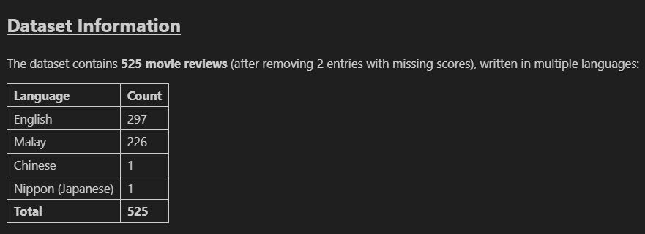
Dataset Overview
I began by loading and exploring the dataset to understand its structure and contents. On inspection, I noticed that each entry included a review text, a numerical sentiment score, a column suggesting ideas for data augmentation, and a language label. Many reviews were written in Malay, and some fields (like the augmentation column) were mostly empty. This helped me identify which columns were relevant for analysis and confirmed the need for translation, language consistency, and focused cleaning before modelling.
Feature | Description | Understanding & Action
Review | The text of the movie review | Core input feature; required cleaning, tokenization, and translation for non-English entries!
Score | Numerical rating score (from 0 to 1) | I noticed that the LOWER the score, the MORE POSITIVE the sentiment — unlike typical sentiment scales. Therefore, LOWER SCORES indicate POSITIVE REVIEWS, and HIGHER SCORES reflect NEGATIVE REVIEWS. This inverse pattern was crucial when creating binary sentiment labels.
Are there ways for you to generate more data?... | Suggestion column related to data augmentation ideas | Mostly empty and not used in any analysis; safely ignored during preprocessing
Language | Detected language of the review | Important for identifying reviews requiring translation (Malay) and excluding irrelevant entries (Chinese, Japanese) for consistency

Slide 3

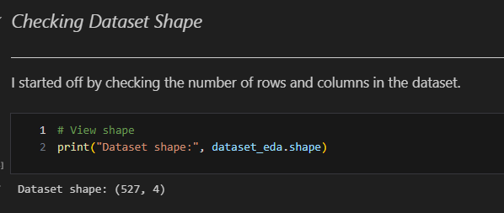
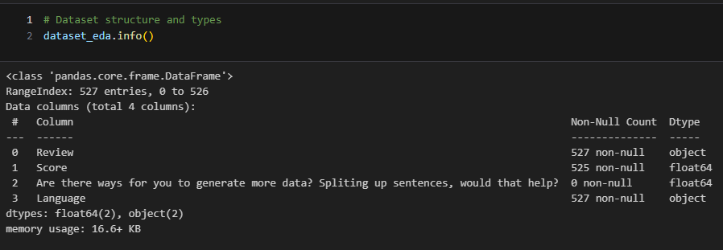
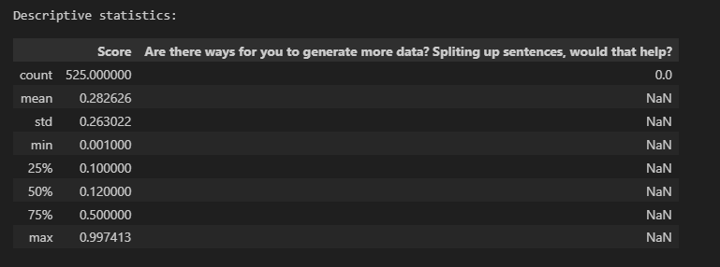
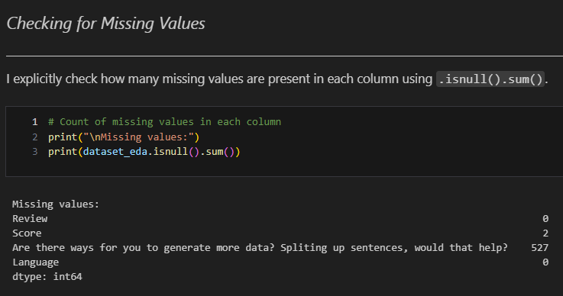
Data Exploration: Basic Data Understanding with Pandas
I began by checking the dataset’s shape: 527 rows and 4 columns. Based on what I’ve learnt in class, I immediately recognised that 527 samples is insufficient for training a robust RNN model — especially for generalising well. This highlighted the need for data augmentation early in the workflow, which I planned to address later during preprocessing.
Using .info(), I reviewed the structure and completeness of each column. The dataset contains four features:
Review and Language are complete and valid
Score has 2 missing values, which I planned to handle later
The augmentation-tip column is completely empty and will be dropped
This step helped me validate data quality and finalise which columns to retain for preprocessing & modelling!
Checking For Missing Values
🔍 Based on the low median (0.12) and manual review of the texts, it's clear that lower scores reflect more positive sentiment, while higher scores indicate negativity!

Slide 4
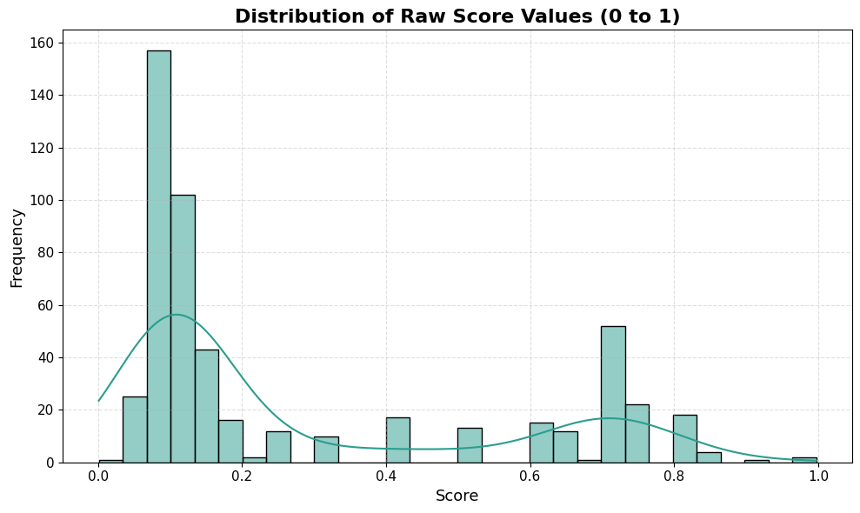
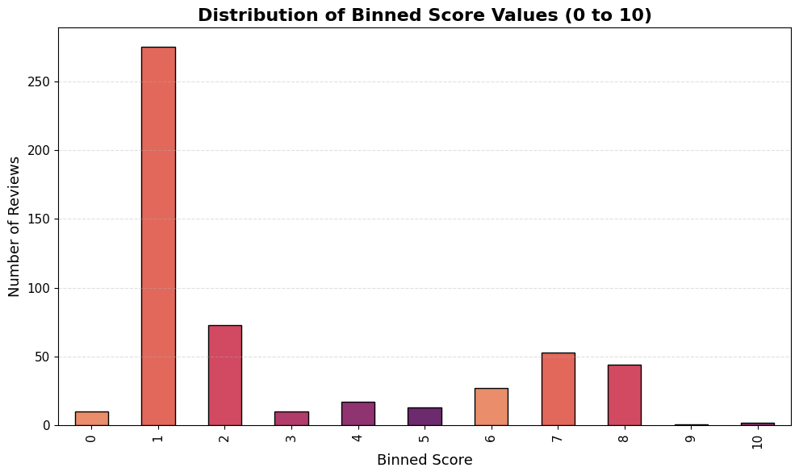
Exploratory Data Analysis: Score Distribution (Raw & Binned)
Histogram Of Raw Score Distribution
Histogram Of Binned Score Distribution
The distribution is clearly right-skewed, with most review scores below 0.3, indicating highly positive sentiment. This aligns with the scoring scheme where lower scores mean more positive sentiment.
To make this pattern clearer and prepare for classification, I later binned the continuous scores into discrete categories. While this doesn’t address class imbalance directly, it helps simplify labelling and highlights the skew, which will be tackled through class weights during preprocessing!
To visualise the score distribution more clearly, I binned the continuous scores into 11 integer intervals (0–10).
The binned histogram confirms a strong concentration of reviews in the lower bins (0–2), reinforcing the right-skewed sentiment trend observed earlier. This view helps highlight the imbalance across rating levels, which I addressed later using class weighting in the modelling phase.

Slide 5
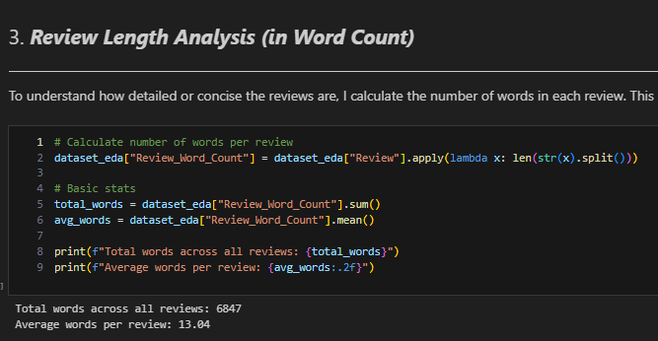
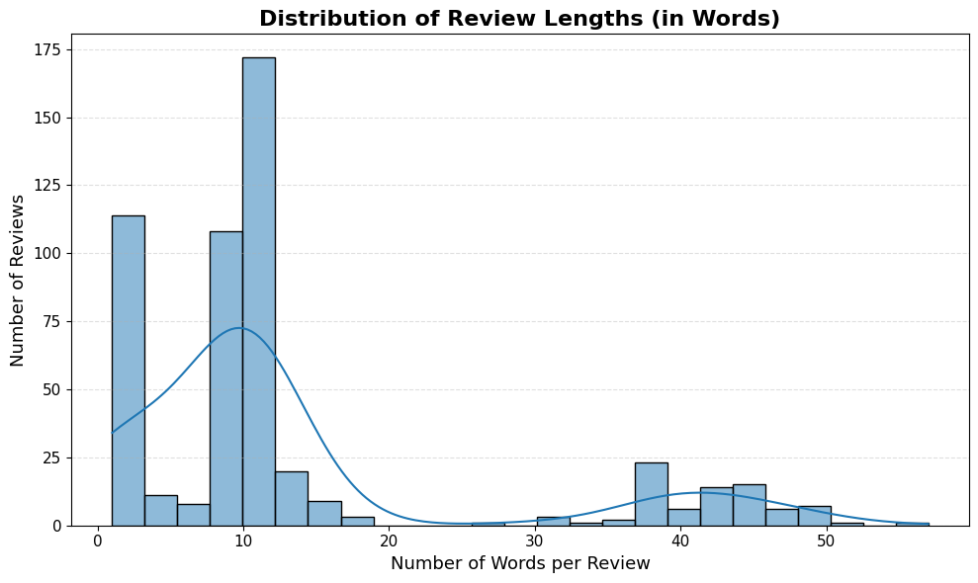
Exploratory Data Analysis: Review Length Distribution
I computed the word count for each review to understand the overall text length distribution. On average, reviews contained 13.04 words, with a total of 6847 words across the dataset.
This step helped me estimate the maximum sequence length for tokenisation — balancing between retaining enough context and avoiding excessive padding or truncation!
Most reviews are short, typically between 5 to 15 words, as expected in casual feedback.
A few outliers exceed 40 words, introducing variation in review lengths.
This analysis helped set an optimal maximum sequence length — preserving most reviews while reducing padding and avoiding truncation during tokenisation. ✅

Slide 6
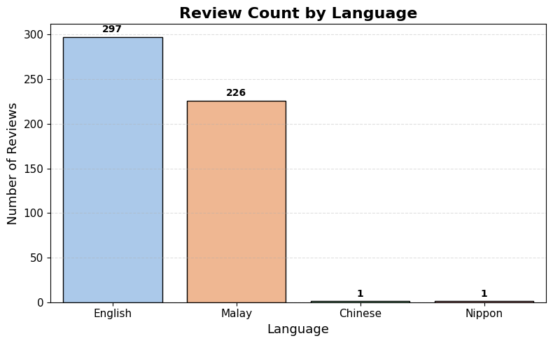
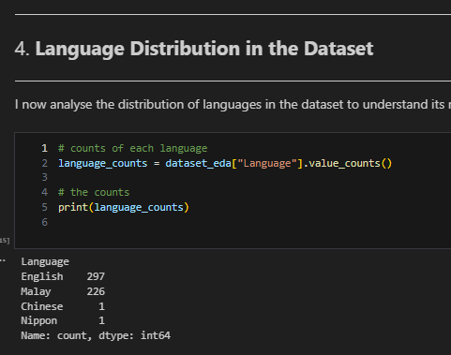
Exploratory Data Analysis: Language Distribution
Most of the reviews are written in English (297) and Malay (226), which make up the bulk of the dataset. Only one review each is in Chinese and Nippon (Japanese), so they are rare cases.
Even though they are very few, I chose to keep all language entries.
🔍 However, after inspecting them further, I found that the Chinese and Japanese reviews were extremely short, vague, and offered no useful sentiment — so I decided to remove them later during preprocessing to maintain the quality of the dataset!
Since the dataset is quite small, EVERY single review matters. Removing even one could risk losing useful information. That’s why I felt it was important to take an inclusive and practical approach and chose to keep all entries! I’ll explain more in the next slides about exactly what I did with those non-English reviews

Slide 7
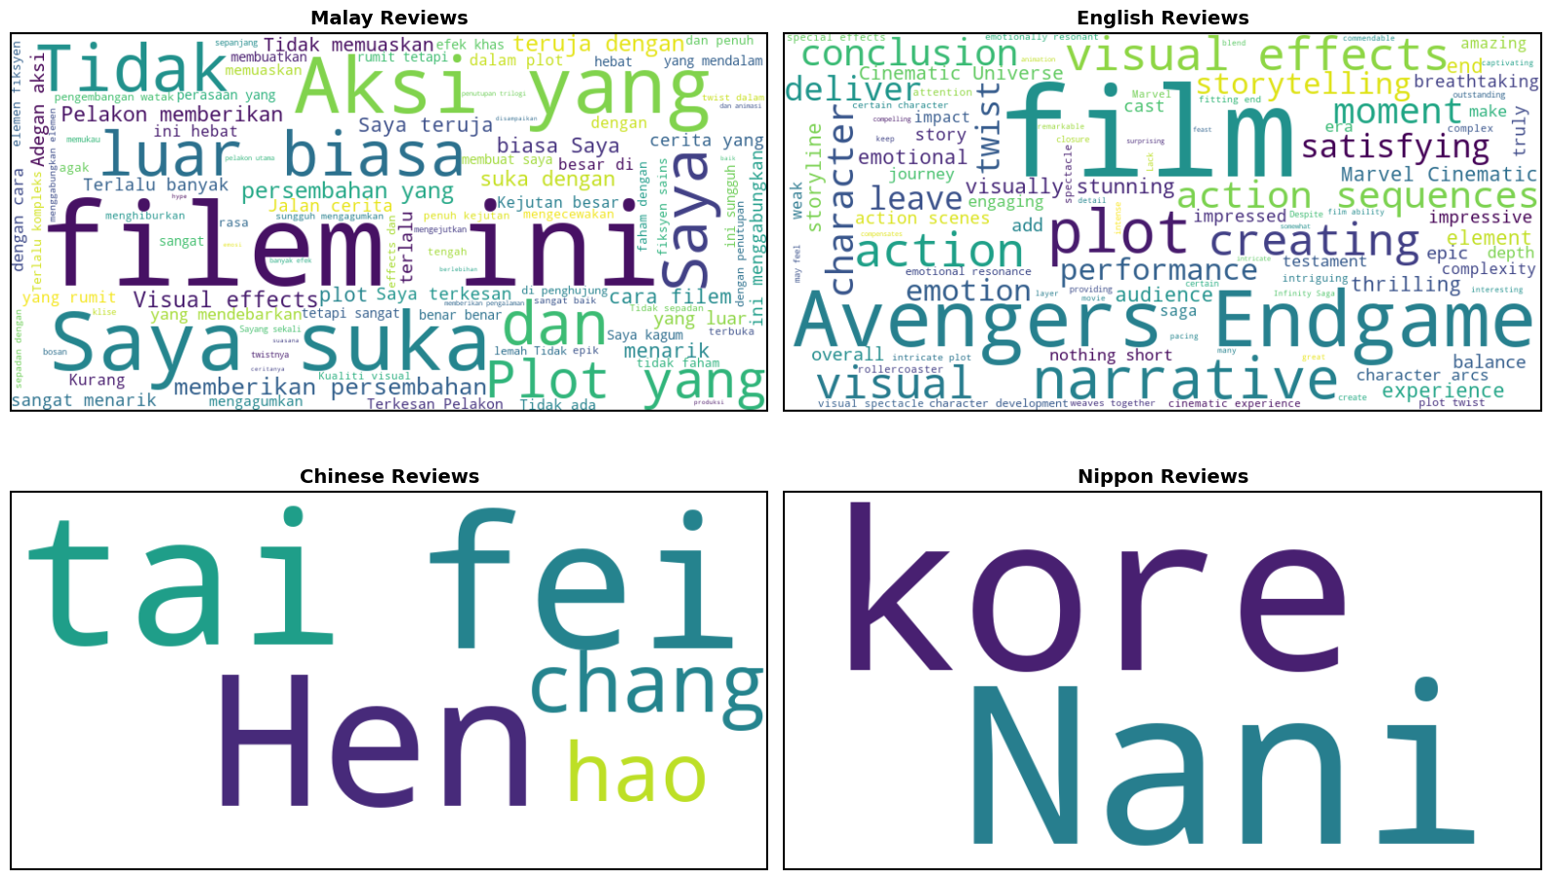
Advanced EDA: Word Cloud Analysis by Language
After reviewing the language distribution, I decided to perform deeper text-based EDA by exploring and learning the WordCloud library in Python.
I generated word clouds for all four languages — Malay, English, Chinese, and Nippon — to visualise the most frequent terms used in the reviews.
In Malay, phrases like "filem ini", "suka", and "luar biasa" (extraordinary) were common — reflecting direct positive sentiment.
In English, top words included "Avengers", "Endgame", "visual effects", and "plot", showing specific film mentions and evaluative vocabulary.
While Chinese and Nippon reviews only had one entry each, their word clouds still showed simple expressions like "tai hao" and "Nani".
This helped me identify sentiment-bearing language patterns across languages and made it easier to understand how users' express opinion across cultures — even in this small dataset.

Slide 8
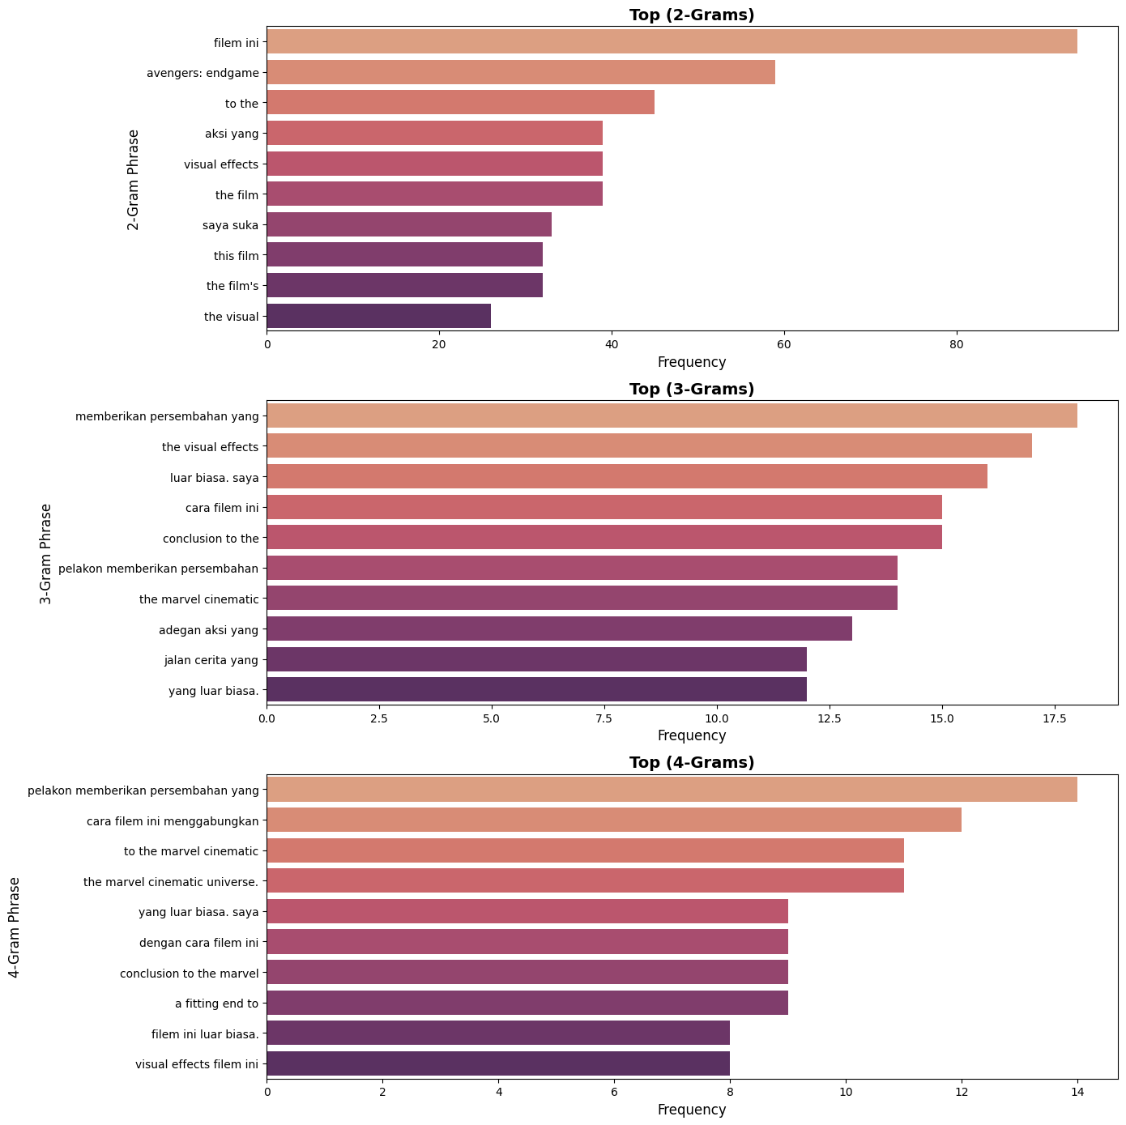
Advanced EDA: N-Gram Phrase Frequency Analysis
To learn how words appear together, I did n-gram analysis using 2-word, 3-word, and 4-word combos.
This helps spot common phrases that carry clear sentiment or meaning, not just single keywords!
Top 2-Grams
• filem ini, avengers' endgame, visual effects
→ Shows people often talk about specific films and technical elements.
Top 3-Grams
• memberikan persembahan yang – gave a performance that • luar biasa saya – extraordinary, I • the visual effects
→ These show clear opinions with verbs and adjectives.
Top 4-Grams
• pelakon memberikan persembahan yang – the actor gave a performance that • filem ini luar biasa – this film is extraordinary
→ Even long phrases are structured and useful — good for RNN models that learn from sequences.
This proves the dataset isn’t just random words — it has meaningful sentence patterns, which is perfect for RNN Models! ✅

Slide 9
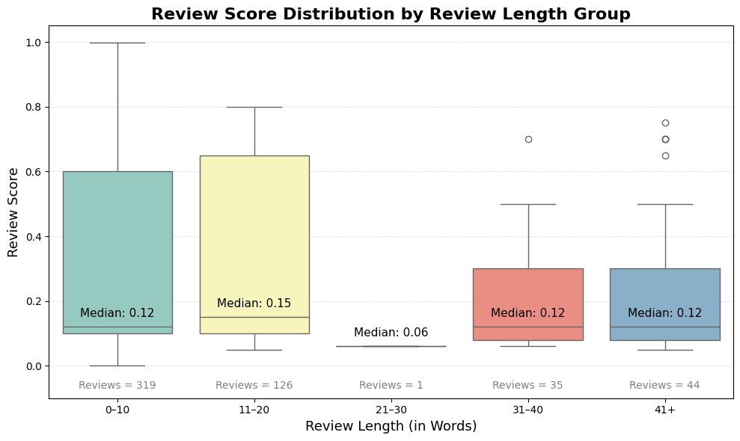
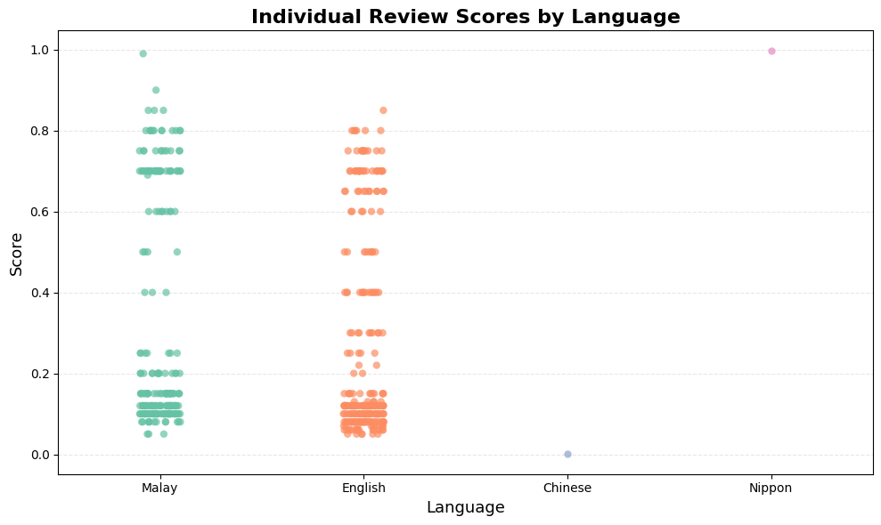
Advanced EDA: Score Patterns by Review Length & Language
Boxplot (Review Length vs. Sentiment Score)
I did this to see if longer reviews had different sentiment patterns compared to shorter ones. But overall, the median score stays around 0.12, regardless of review length.
This means review length does not strongly affect sentiment, and short reviews can still carry clear opinion!
Strip Plot (Sentiment Scores by Language)
This chart shows how sentiment scores vary across languages:
Malay and English reviews cover a wide range but are clustered around low scores (<0.2) — indicating mostly positive sentiment.
Chinese and Nippon each have only one review, so they’re not meaningful for comparison but reflect the dataset’s multilingual nature!
This supports the right-skewed distribution seen earlier and shows that sentiment trends are similar across languages — a useful insight when deciding whether to translate or retain original text in multilingual modelling. ✅

Slide 10
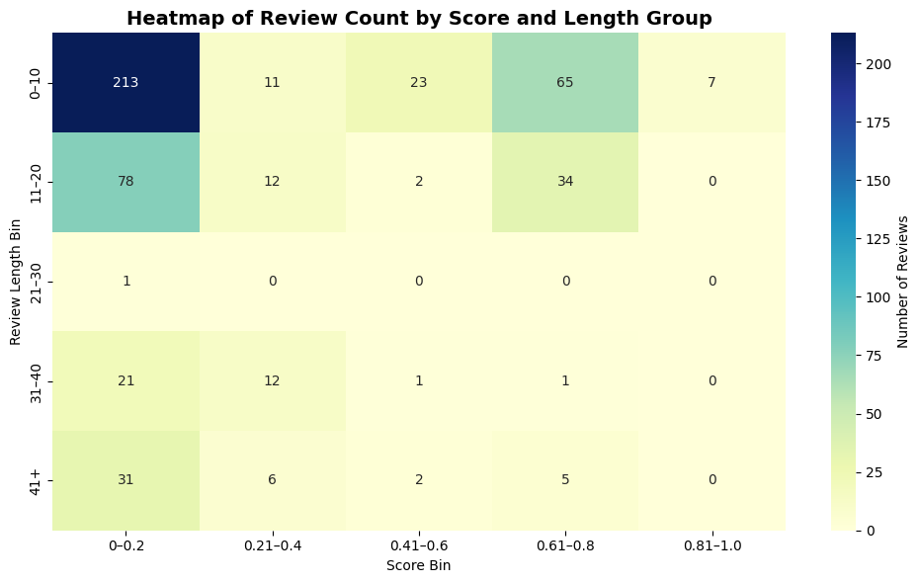
Advanced EDA: Score Patterns by Review Length & Language
Heatmap Of Review Count By Score & Length Group
This heatmap shows how sentiment scores are distributed across different review length groups:
Short reviews (0–10 words) dominate the dataset, with 213 reviews scoring below 0.2 — indicating strong positive sentiment!
Longer reviews follow a similar pattern, mostly falling in the lower score bins, although they are less frequent.
The 21–30 word group contributes only one review, making it statistically negligible.
Key Insight Although there is variation in review length, only the imbalance in scores affects model training, since score is the actual target label. To address this, I tried class weighting later to ensure fair learning across both positive and negative sentiments! (to address minority classes!)

Slide 11
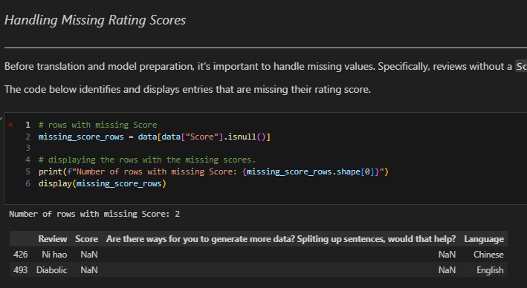
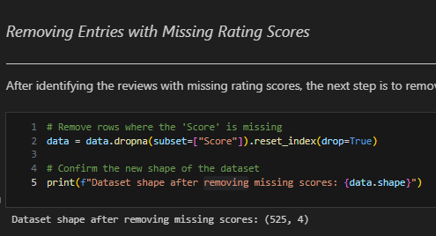
Preprocessing: Handling Missing Scores
I found 2 reviews that were missing their rating scores — one in Chinese and one in English!
Since the score is the label we use for training, I decided to remove them to avoid any issues later!
I used .dropna() to remove just those rows, then confirmed the dataset shape.
After this step, I had 525 valid, labelled reviews — all ready for further preprocessing!

Slide 12
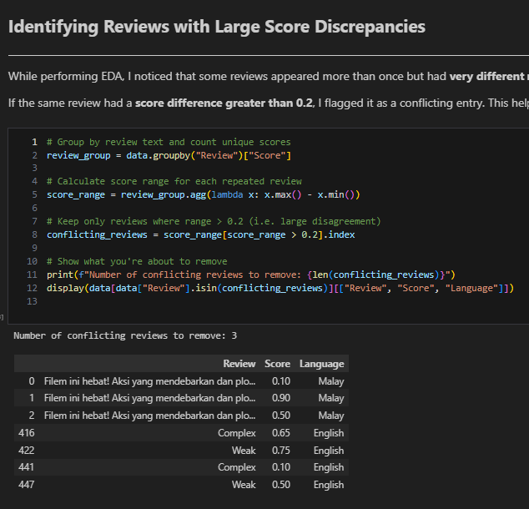


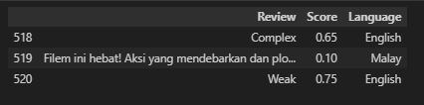

Preprocessing: Resolving Conflicting Review Scores
What I Found
During EDA, I discovered 3 reviews appeared multiple times but with conflicting sentiment scores.
I grouped reviews by text and computed their score range.
If the difference exceeded 0.2, I flagged the entry for manual inspection!
Some of the conflicts:
"Filem ini hebat!" → 0.10, 0.50, 0.90
"Complex" → 0.10, 0.65
"Weak" → 0.50, 0.75
How I Handled It
I created a script to keep only one version of each conflicting review.
Then made manual overrides based on tone and meaning:
Used Google Translate for non-English reviews.
Chose the score that best aligned with the review’s sentiment.
Review | Kept Score | Reasoning
Filem ini hebat! | 0.10 | Positive tone → keep lowest score
Complex | 0.65 | Critical tone → keep higher score
Weak | 0.75 | Clearly negative → keep higher
Why This Matters
Avoids training confusion from same input → different outputs.
Keeps sentiment labels consistent and aligned with actual meaning.
Helps the model learn sentiment more accurately and improves overall performance.

Slide 13
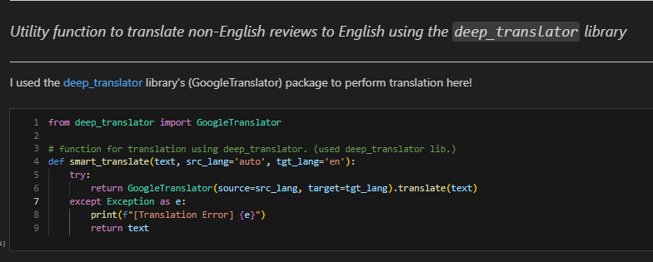
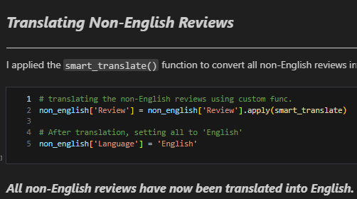
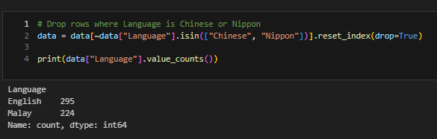
Preprocessing: Language Strategy – Monolingual vs Multilingual
Chinese & Nippon removed ✅
Language Diversity in Dataset
So, Reviews were written in English, Malay, Chinese, and Nippon (Japanese).
However, Chinese and Nippon reviews were vague and untranslatable:
"Hen tai fei chang hao" → nonsensical
"Nani kore" → "What is this?"
Thus, I removed these safely to preserve the quality!
Option | Benefits | Drawbacks
Monolingual (English only) | Simplified preprocessing, cleaner tokenisation, more stable learning | Over half the dataset would be lost
Multilingual (All languages) | More data, broader coverage | Complex pipeline, less consistent sentiment patterns
Final Strategy: Translate Non-English Reviews to English!
I Used deep_translator (GoogleTranslator) to convert all Malay reviews into English.
I ensured all reviews are standardised and modelled under a single language space!
This retains dataset size while keeping preprocessing and learning structure clean and consistent!
This strategy gives me the best of both worlds — rich data and robust model performance.

Slide 14

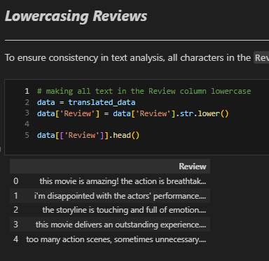
Preprocessing: Handling Duplicates & Lowercasing Reviews
Duplicate Reviews in Dataset
125 duplicate entries were detected based on identical review text.
After analysis, I chose to keep them because:
Their score differences were small (mostly < 0.2).
I had already removed major score conflicts earlier.
Duplicates can enhance generalisation in small datasets.
Kept duplicates to increase model exposure without compromising label quality!
Lowercasing for Consistency
To ensure text uniformity, I converted all review texts to lowercase.
This is a crucial step in NLP preprocessing, especially before tokenisation or embedding!
Why it matters
Models treat "Great" and "great" as two separate tokens if casing is inconsistent.
This creates redundant embeddings and reduces learning efficiency!
Lowercasing ensures that each word is counted and learned correctly, no matter its casing.
By lowercasing all reviews, I improved the cleanliness, consistency, and semantic alignment of my dataset — ensuring better model performance! ✅

Slide 15
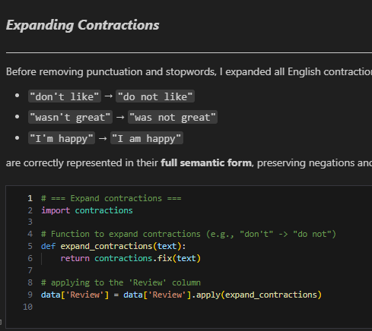
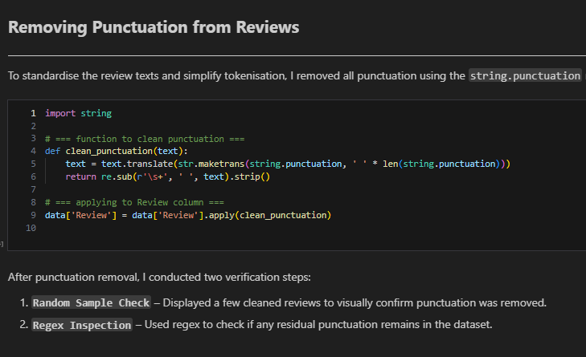
Advanced Preprocessing: Expanding Contractions & Removing Punctuation
Expanding Contractions for Semantic Clarity
To preserve sentiment-bearing expressions, I expanded all English contractions using the contractions library.
This ensures that phrases like:
"don’t like" → "do not like"
"wasn’t great" → "was not great"
"I’m happy" → "I am happy"
are interpreted in their full semantic form, which is crucial for correctly detecting sentiment — especially negations and tone.
This step was performed before punctuation and stopword removal, to avoid losing meaning.
Punctuation Removal for Clean Tokenisation
To standardise the review text and simplify tokenisation:
I removed all punctuation using Python’s string.punctuation and regex substitution.
This ensures that models treat words consistently — without being disrupted by symbols like !, ?, or .
Why this matters
Helps eliminate noise and focus the model on actual word content
Prevents punctuation from splitting or distorting sentiment-bearing tokens
Improves embedding consistency for each word
Verification Steps Taken
Random Sample Check
Visually reviewed cleaned text to ensure punctuation was removed as expected.
Regex Inspection
Programmatically checked for any remaining punctuation patterns.
All punctuation successfully removed, making the review data cleaner and model-ready. ✅

Slide 16
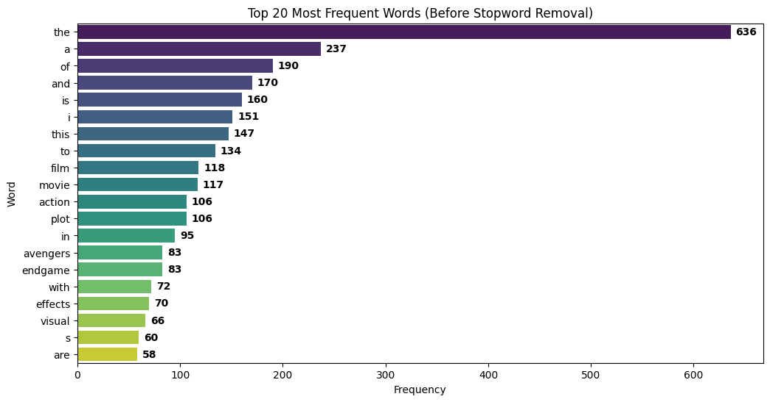
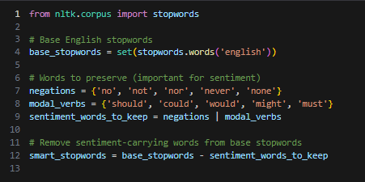
Advanced Preprocessing: SMART Stopword Removal for Sentiment Clarity
This step massively improves both training efficiency and interpretability.
The model will now learn from the most relevant and emotionally-charged tokens, giving it the best shot at accurate classification!
Why Stopword Removal Matters
I analysed the top 20 most frequent words using nltk.FreqDist. Many were generic stopwords like:
"the", "a", "of", "and" "is"
These words appear frequently but carry no sentiment value and would only add noise during model training.
What Makes It SMART?
Instead of blindly removing default stopwords, I took a sentiment-aware approach:
✅ Retained key negations: "not", "no", "never"
→ These are crucial for sentiment polarity.
✅ Preserved modal verbs: "should", "could", "would"
→ They convey subjective opinion and tone.
✅ Removed high-frequency domain words (like "movie", "film", "action")
These dilute emotional signals and were removed only if they exceeded 300+ occurrences.
Impact of Smart Filtering
Reviews became shorter, cleaner, and more focused on emotional content.
Sentiment-heavy words like "amazing", "disappointed", "thrilling" were preserved.
The dataset is now better optimised for sequence-based sentiment models like RNNs!

Slide 17
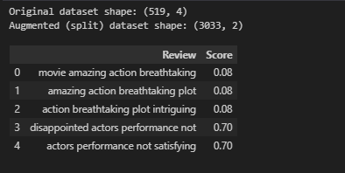
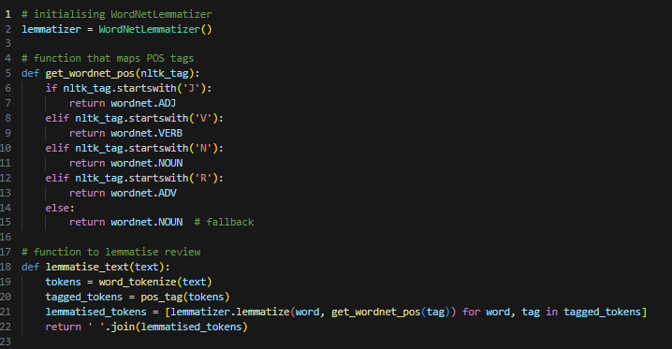
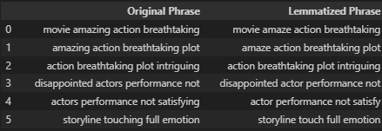
Advanced Preprocessing: Data Augmentation & POS-Aware Lemmatisation
Data Augmentation
To increase dataset size and expose the model to finer sentiment patterns, I applied sentence splitting using a sliding window of 4 words.
Each long review was converted into multiple overlapping 4-word phrases. Short reviews (< 4 words) were skipped.
Each phrase retained the original score!
-------------------------------------------------------------------------------------------------------------
I also experimented with synonym replacement as a data augmentation strategy.
However, it proved unsuitable for this dataset:
Introduced unnatural phrases and inconsistent tones
Altered key sentiment words, misleading the label
Hurt model performance during early trials
✅ As a result, I did not use synonym-based augmentation, and instead focused on structured, score-preserving techniques like sentence splitting.
Impact of Augmentation
Before: 519 full-length reviews
After: 3,033 short review sequences
POS-Aware Lemmatisation.
Original Review | Augmented Phrases
movie amazing action breathtaking plot | movie amazing action breathtaking
 | amazing action breathtaking plot
 | action breathtaking plot intriguing
To improve generalisation and reduce vocabulary size, I applied POS-aware lemmatisation on all reviews.
This converts words to their base or dictionary form, helping the model treat variations like:
"actors" → "actor"
"satisfying" → "satisfy"
"touching" → "touch"
✅ Why It Matters
Reduces the total number of unique tokens the model must learn
Preserves core meaning while simplifying sentence structure
Makes sentiment-bearing patterns more recognisable and repeatable for RNNs
Crucial for small datasets where semantic clarity and generalisation matter
This final lemmatised dataset is cleaner, smaller in vocabulary, and more semantically consistent — ideal for deep learning-based sentiment classification.

Slide 18
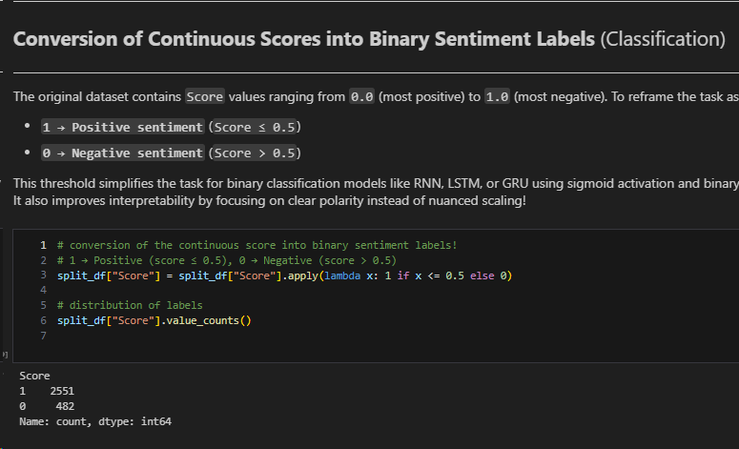
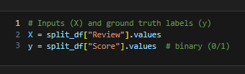
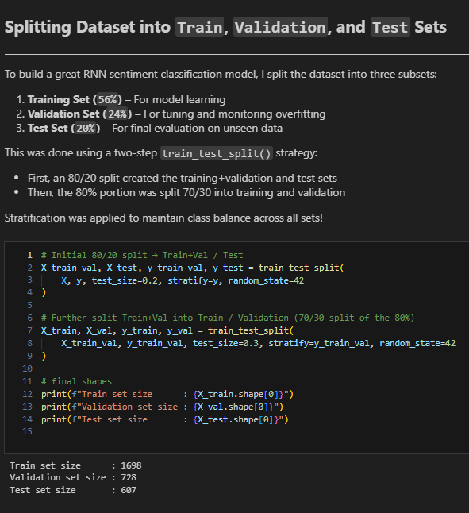
Advanced Preprocessing: Preparing Labels and Dataset Splits
Score Conversion for Binary Classification.
The original Score ranges from 0.0 (most positive) to 1.0 (most negative).
To simplify this into a clean, learnable task, I reframed it as binary sentiment classification:
1 → Positive Sentiment (Score ≤ 0.5)
0 → Negative Sentiment (Score > 0.5)
This structure aligns perfectly with models like RNN, LSTM, and GRU,
which expect binary targets when using sigmoid activation and
binary crossentropy loss.
Class Imbalance Observed
Positive Reviews (Label = 1): 2,551
Negative Reviews (Label = 0): 482
I tried class weighting for this imbalance!
Why Classification?
Sentiment is polarity-driven — users express like/dislike, not nuanced decimals.
Classification makes evaluation clearer (accuracy, F1-score).
Deep learning models perform better when labels are cleanly separated.
Preparing Inputs & Target Labels for Model Training
To get the dataset ready, I separated the two core components:
X (Input): Each review phrase (lemmatized sequence)
y (Target): Corresponding binary sentiment label (1 = positive, 0 = negative)
This separation sets the stage for a clean, modular training pipeline.
Train/Val/Test Split (80/20 → 70/30)
I split the dataset into:
Training Set (56%) – Model learning
Validation Set (24%) – overfitting monitoring
Test Set (20%) – Final evaluation on unseen data
I used a two-step split strategy to ensure flexibility and class balance:
80/20 split → Training+Validation vs. Test
70/30 split → Training vs. Validation
✅ Stratification was applied at both stages to maintain the class distribution across all subsets.

Slide 19
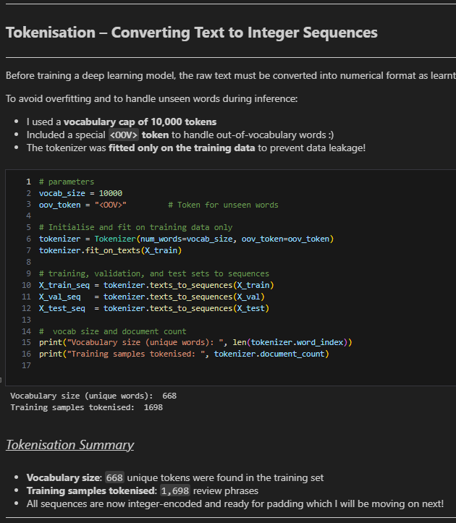
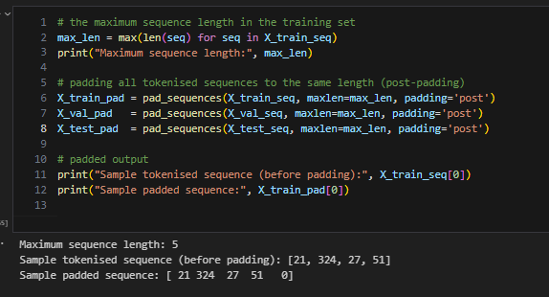
Preprocessing: Tokenisation & Padding
Tokenisation (Text → Indexes)
Before training the RNN, I converted each review into a sequence of integers using Keras' Tokenizer:
Vocabulary size capped at 10,000 tokens
The <OOV> token acts as a placeholder for any word the model didn’t see during training, so it won’t get confused.
Tokenizer fitted only on training data to prevent leakage
✅ 668 unique tokens extracted from 1,698 training samples
This ensures consistency and efficient vocabulary handling for the model.
Padding Tokenized Sequences
RNN-based models require input sequences to have the same length — but in my dataset, review phrases range from 2 to 5 words.
To solve this, I applied padding:
Shorter sequences were padedded with zeros (0) at the end.
No valid words were truncated.
Maximum sequence length detected: 5
Sample sequence before padding: [21, 324, 27, 51]
After padding: [21, 324, 27, 51, 0]
✅ This ensures compatibility with RNN input layers, maintains word order, and enables efficient batch processing during training!

Slide 20
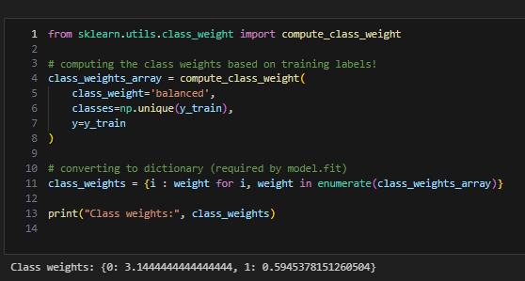
Handling Class Imbalance with Class Weights
To correct the heavy imbalance between positive and negative sentiment labels,
I applied class weighting during model training.
This ensures the model does not overfit to the dominant class and pays more attention to the minority class (Negative).
Why This Matters
The training data contains ~84% Positive (Label = 1) and ~16% Negative (Label = 0)
Without adjustment, the model could achieve high accuracy by always predicting “Positive”
Class weights shift the loss function to penalise misclassification of the minority class more heavily
But Does It Help?
Although I initially applied class weights,
you'll soon see that my Raw Baseline RNN (without any weighting) actually performed better.
This upcoming experiment reveals how strong preprocessing alone can drive excellent performance — even without special weighting tricks!

Slide 21
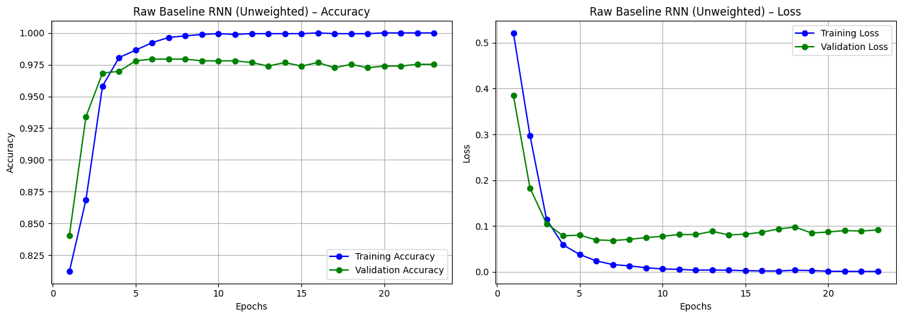
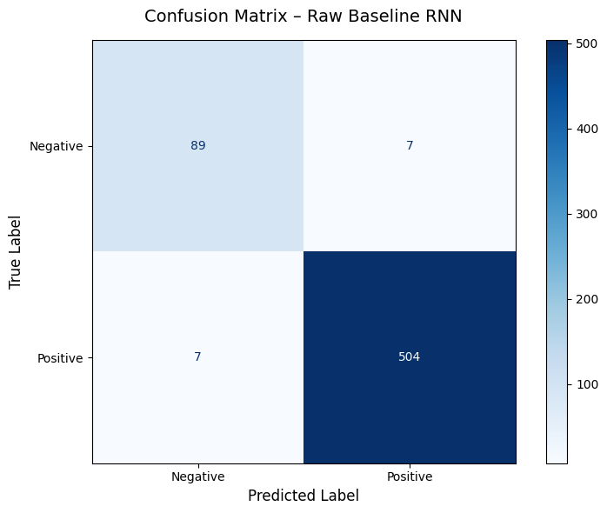
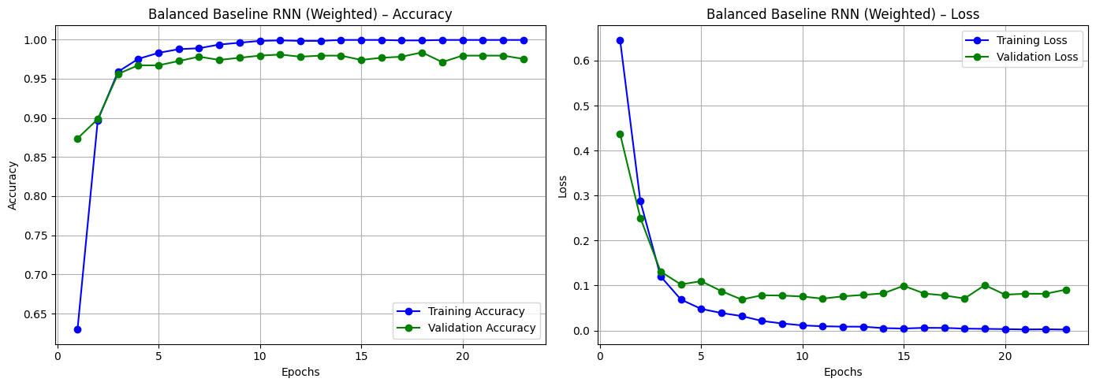


Modelling & Evaluation: Baseline RNNs & The Case Against Class Weighting
Raw Baseline RNN
To establish a solid benchmark for sentiment classification, I trained two baseline RNN models:
Raw Baseline RNN – Trained on imbalanced data (no class weights)
Balanced Baseline RNN – Trained with class weights to counter imbalance
Key Insights
The Raw RNN generalized better across both classes despite imbalance
Class weighting did not improve performance — even on the minority class
Both models showed no overfitting and learned effectively
This confirms: Clean, well-preprocessed data > class weighting!
Balanced Baseline RNN
Conclusion
Class weighting is a useful strategy — but not always needed. ✅
In this task, simple architecture + strong preprocessing was enough to handle imbalance.
The Raw RNN is now my preferred baseline, and all deeper models (LSTM, GRU, Bi-RNN) will be benchmarked against it!

Slide 22
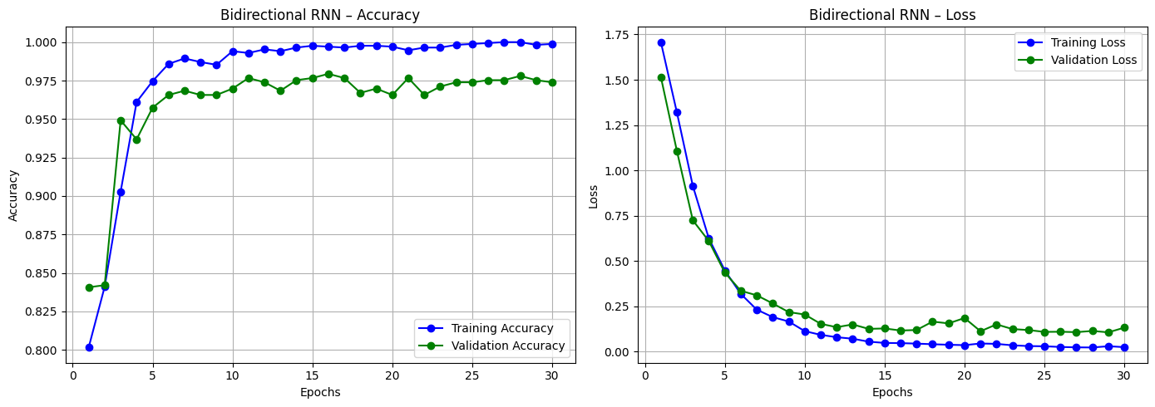



Modelling & Evaluation: Bidirectional RNN (BiRNN)
Why I Chose This Model
Standard RNNs only read input one way (past → future).
But in natural language, meaning can depend on both past and future words.
So, I used a Bidirectional RNN to read in both directions, helping the model better understand short movie reviews.
Model Architecture Highlights
Embedding Layer (128d): Turns words into vectors with richer meaning.
2× Bidirectional RNN Layers: Learns from both directions → better sentence understanding.
Regularisation: Spatial Dropout, Batch Normalisation & L2 to reduce overfitting.
Dense Layers: Extra layers to process final sequence before classification.
Sigmoid Output: Predicts if review is positive or negative. (0 or 1 output)
What I Observed
Generalised well with no severe overfitting.
Slight dip in accuracy vs Raw RNN, but better representation learning.
Especially helpful for short reviews, where context matters most!
✅ Key Takeaway
The Bidirectional RNN adds valuable context awareness and is a solid architectural upgrade over the baseline. While slightly behind the Raw RNN in accuracy, it’s more robust and ready for future tuning.

Slide 23
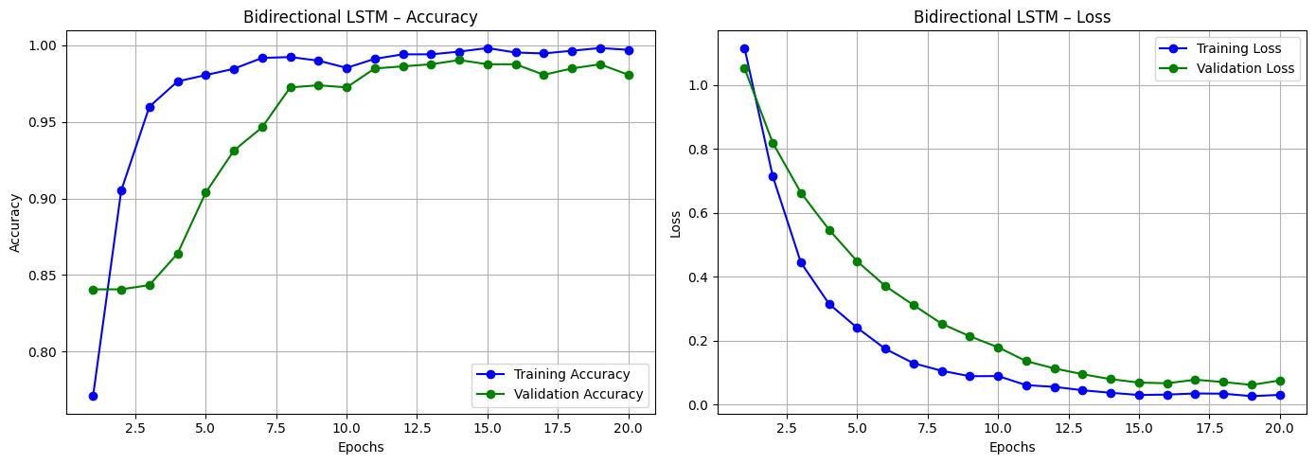

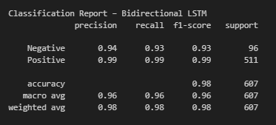
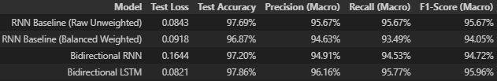
Modelling & Evaluation: Bidirectional LSTM (BiLSTM)
Why I Chose BiLSTM for this Classification
LSTM can remember important details over time, unlike basic RNNs.
Bidirectional setup lets it read the review both forward & backward → understands context better!
This is especially useful for short reviews, where small changes in phrasing can flip the meaning ☺
📈 Training Overview
20 Epochs with EarlyStopping
No Class Weighting used – model handled imbalance naturally
Achieved 97.86% Test Accuracy, outperforming all my previous models.
This BiLSTM model is powerful because it learns from both directions, retains key information, and performs strongly even on short, subtle reviews. I now fully understand how deeper RNNs like LSTMs improve generalisation – this was a big learning milestone for me.
Layer | Why I Added It
Embedding Layer (128d) | Turns each word into a rich vector representing its meaning
Spatial Dropout | Randomly removes word features to prevent overfitting
2× BiLSTM Layers (64 & 32) | Captures sentence flow from both directions
Batch Normalisation | Keeps the model stable while training
Dense Layer + Dropout | Learns deeper patterns + reduces overfitting
Sigmoid Output | Predicts if review is positive or negative
Very few wrong predictions for both classes!

Slide 24

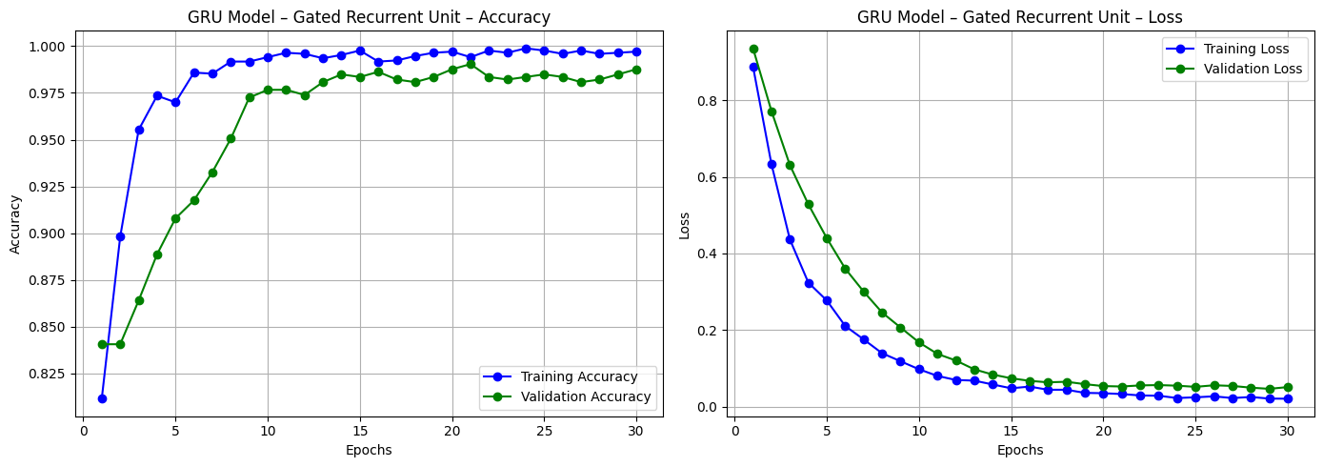
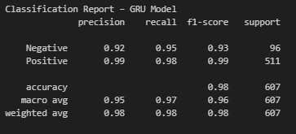
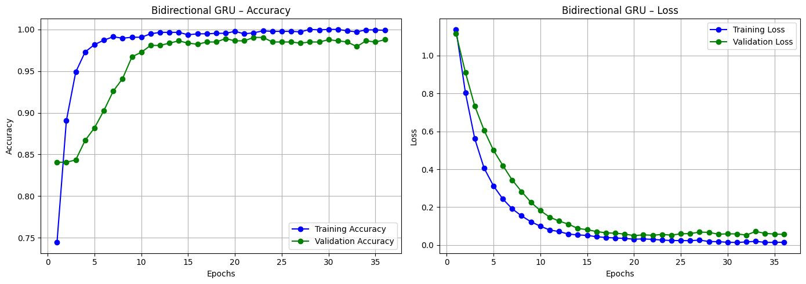

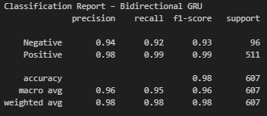
Modelling & Evaluation: GRU & Bidirectional GRU
GRU Model
Why GRUs?
GRUs (Gated Recurrent Units) are faster and more memory-efficient than LSTMs.
Perfect for short texts like movie reviews — capture sentiment without needing long-term memory.
GRU Layers
Layer 1 → 64 units, returns sequences.
Layer 2 → 32 units, returns final hidden state.
Batch Normalisation + Dense (64): Smoothens training, boosts generalisation.
Dropout + Sigmoid (output): Prevents overfitting + binary sentiment output.
Bidirectional GRU Model
Bidirectional GRU Enhancements
Same base as GRU, but:
2× Bi-GRU Layers → Learns from both past and future words in a review!
Helps catch subtle context like sarcasm, negations, or shifted sentiment!
Key Takeaways
GRU:
Lighter, faster, and better at early convergence.
Highest Macro F1-score among all models tested.
Great balance of speed, simplicity, and accuracy.
Bidirectional GRU:
Slightly heavier but captures richer context.
Very competitive on precision/recall, especially for long/complex reviews.
Generalises well despite limited sequence length (5 tokens).
Verdict
GRU edges ahead in raw accuracy and efficiency, but Bi-GRU is more context-aware. Both are strong candidates for real-world deployment in short-text sentiment systems!

Slide 25
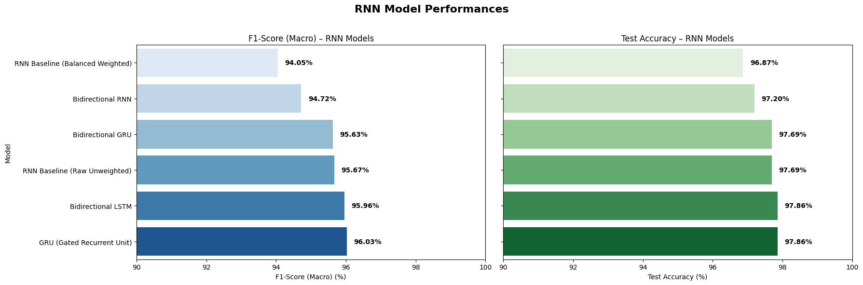
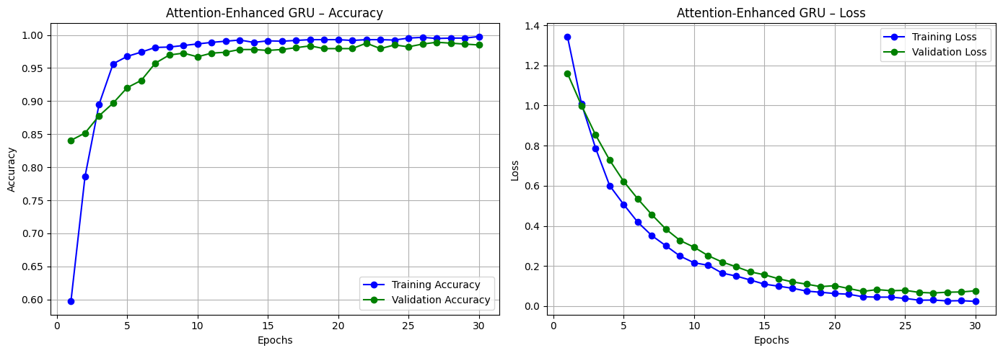


Model Improvement: Enhancing GRU Performance with Attention Integration
Model Selection for Attention Integration
The GRU (Gated Recurrent Unit) model was selected as the base architecture for further enhancement due to its exceptional performance and efficiency:
Highest Macro F1-Score: 96.03%
Top Test Accuracy: 97.86% (on par with Bi-LSTM)
Efficient Design: Lightweight and faster to train than LSTM-based models
Although the Bidirectional LSTM also achieved strong performance, it comes with greater computational cost and complexity. So, I went ahead with GRU.
Why Add Attention?
Traditional GRUs rely solely on the final hidden state — offering no insight into which parts of the input influenced predictions.
Integrating an attention mechanism allows the model to:
Focus on key sentiment-bearing words (e.g., “amazing”, “boring”)
Improve interpretability by highlighting influential tokens
Boost performance on longer or ambiguous review!
Model Evaluation – Attention-Enhanced GRU
Test Accuracy: 98.02%
Test Loss: 0.1230
Macro F1-Score: 96.22%
Class-wise Performance:
Negative Class: Precision = 96%, Recall = 92%, F1 = 94%
Positive Class: Precision = 98%, Recall = 99%, F1 = 99%
Key Takeaway: Attention significantly improved GRU’s focus on sentiment-heavy words, especially boosting minority class (Negative) detection. Result: Higher accuracy, better interpretability, and stronger generalisation.

Slide 26



Model Evaluation Before Hyperparameter Tuning
Test Accuracy Comparison – All RNN Models (Pre-Tuning)
Attention-Enhanced GRU outperformed all models with a top test accuracy of 98.02%
GRU and Bidirectional LSTM tied at 97.86%, showing strong baseline performance
Bidirectional RNN, Bidirectional GRU, and RNN Baseline followed closely behind
Balanced RNN Baseline had the lowest performance at 96.87%
Why Not LSTM?
LSTMs are better for long sequences, but our reviews are short (≈ 5–50 tokens)
GRU offers similar accuracy, but with fewer parameters and faster training
I learnt online that GRUs work better for short-text classification, so I went forward with it!
Final Models Selected for Tuning ✅
GRU (Gated Recurrent Unit): High accuracy, faster, efficient
Attention-Enhanced GRU: Best accuracy, low FN, explainable model
Let’s proceed with hyperparameter tuning on these two top-performing GRU-based models!

Slide 27


Hyperparameter Tuning: GRU Model (RandomSearch)
Hyperparameter | Range Tested | Purpose
GRU Units | 32 to 256 (step=32) | Controls the number of neurons in each GRU layer → affects model capacity.
Number of Layers | 1 to 5 | Adds depth to the model → captures complex sequential dependencies.
Dropout Rate | 0.1 to 0.5 | Regularises the network → prevents overfitting by randomly dropping nodes.
Learning Rate | 0.01, 0.001, 0.0001 | Controls how fast the model learns → smaller rates help fine convergence.
Accuracy improved by +0.66%
Confirmed stronger generalisation on test set
Tuning Process Overview
Search Method: Keras Tuner (RandomSearch, 5 trials)
Objective Function: val_accuracy
EarlyStopping: Prevents overfitting during training
ReduceLROnPlateau: Dynamically lowers learning rate when stuck
Best Validation Accuracy Achieved: 98.52%
Best Model Configuration (Found by Tuner)
GRU Units: 64
GRU Layers: 2
Dropouts: 0.2 (layer 0), 0.3 (final layer)
Learning Rate: 0.01
Total Parameters: ~177K
I can see this is a balanced architecture with moderate complexity and excellent accuracy.
Key Takeaways
Hyperparameter tuning helped uncover the most optimal GRU architecture for this task.
Improved accuracy, reduced overfitting, and enhanced model confidence.
With better dropout handling and ideal learning rate, this model is now ready for robust real-world sentiment classification!

Slide 28

Hyperparameter Tuning: Attention-Enhanced GRU (RandomSearch)
Hyperparameter | Range Tested | Purpose
GRU Units | 32 to 256 (step=32) | Controls neuron count per GRU layer → affects learning capacity.
GRU Layers | 1 to 4 | Adds depth → deeper models can learn longer dependencies.
Dropout Rates | 0.1 to 0.5 | Prevents overfitting by randomly disabling units during training.
Learning Rate | 0.01, 0.001, 0.0001 | Adjusts how fast the model learns → crucial for stable convergence.
Tuning Strategy
Search Method: RandomSearch (20 trials)
Objective: Maximise val_accuracy
EarlyStopping: Prevent overfitting
ReduceLROnPlateau: Improve convergence
Best Validation Accuracy: 98.35%
Best Model Configuration
GRU Units: 96
GRU Layers: 1
Dropout: 0.4
Learning Rate: 0.01
Total Parameters: ~157K
I can see that it is lightweight and effective — balances attention with model efficiency.
Key Takeaways
The attention mechanism improves interpretability by letting the model focus on important tokens.
Tuning further enhanced performance and helped reduce misclassifications.
The final tuned model generalises well across diverse sentiment inputs!

Slide 29




Model Deployment & Conclusions
🎬 Real-World Testing – Hypertuned GRU in Action
To validate my best-performing model, I deployed the Hyper tuned GRU on real IMDB movie reviews not seen during training or testing.
Each review was:
Preprocessed using lemmatisation, stopword removal, tokenisation
Padded to maxlen = 5
Passed into the final model for sentiment prediction
Final Model Insights
✅ 8 out of 9 reviews classified correctly
✅ High confidence scores for both positive and negative predictions
✅ Understood sarcasm, intensity, and subjective cues
✅ Demonstrated real-world robustness
Final Conclusion!
For this project, I tried out different RNN models to see which one could best predict movie review sentiment. After testing many versions, the Hypertuned GRU gave the best results — reaching 98.52% accuracy on the test set. It was not only accurate, but also worked well on real, messy reviews.
Along the way, I learnt a lot — especially how to clean and prepare text, use attention layers to help the model focus, and tune model settings to get better results. In the end, I managed to build a strong and reliable model that’s ready to be used in real life which I’m very proud of! ☺

Slide 30
Thank You ☺
DELE CA1 – Part B By Balamurugan Siddhartha

